Slide 1
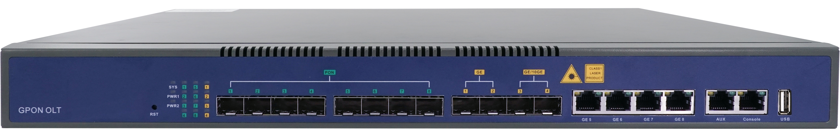

HV1600G1-B
The HV1600G1-B is a pizza-box GPON OLT with 8 PON ports that meets flexible and fast FTTx access, suiting the scenarios such as sparse/ remote/cost-sensitive area,smart industrial park, commercial building and FTTM, etc.
Layer3 GPON OLT
Highlights
Compact design, meets various application scenarios
Supports the deployment in diverse scenarios including low density areas, remote areas, sparsely-populated areas and industry parks.
Supports FTTM and sharing site/rack with wireless base stations.
Small size and lightweight, easier to delivery and install
Small size and lightweight, easy to transport and install.
Supports multiple installation modes, like limited room space,basement, low-voltage room and small rack or cabinet.
Carrier-class security protection, support dynamic routing protocol RIP&OSPF, ensure the safe operation of network
Supports uplink redundancy protection including LACP STP,RSTP and MSTP, and support RIP&OSPF protocol. Supports link protection.
Lower TCO
Dramatically saves on investment fees in trunk fibers, pipe engineering, and facilities. Effectively reduce CapEx and OpEx.

Slide 2
Technical Specifications
Item |  | HV1600G1-B
Chassis | Rack | 1U 19Inch Standard Box
Uplink Port | QTY | 8
 | RJ45(GE) | 4
 | SFP(GE) | 2
 | SFP+(10GE) | 2
GPON Port | QTY | 8
 | Physical Interface | SFP Slots
 | Max splitting ratio | 1:128
Management Ports |  | 1*10/100/1000BASE-T out-band port, 1*CONSOLE port, 1*USB2.0
Backplane Bandwidth (Gbps) |  | 104
Port Forwarding Rate(Mpps) |  | 68.448
PON Port Specification | Transmission Distance | 20KM
 | GPON port speed | Upstream 1.244Gbps, Downstream 2.488Gbps
 | Wavelength | TX 1490nm, RX 1310nm
 | Connector | SC/UPC
 | Fiber Type | 9/125μm SMF
 | Supported PON module level | Class B+, C, C+, C++, C+++
Power supply | AC | Working Voltage Range: 100~240V, Rated Voltage: 110V/220V
 | DC | Working Voltage Range: -36~-75V, Rated Voltage: -48V/-60V
Management Mode |  | EMS, WEB, SNMP, Telnet , CLI
Management Function
SNMP,Telnet,CLI,WEB,SSH v2;
Fan Group Control
Port Status monitoring and configuration management
Online ONTconfiguration and management
User management
Alarm management
Layer2 Switch
32K Mac address
Support 4096 VLANs
Support port VLAN
Support VLAN tag/Un-tag, VLAN transparent transmission
Support VLAN translation and QinQ
Support storm control based on port
Support port isolation
Support port rate limitation
Support 802.1D and 802.1W
Support static LACP,Dynamic LACP
QoS based on port, VID, TOS and MAC address
Access control list
IEEE802.x flowcontrol
Port stability statistic and monitoring
DHCP
DHCP server,DHCP relay,DHCP snooping
DHCP option82
Layer 3 Route
ARP proxy
4096 hardware Host Routes,512 hardware Subnet Routes
Support Radius,Tacacs+
Support IP source guard
Support static route ,dynamic route RIP v1/v2,RIPng and OSPF v2/v3;
IPv6
Support NDP;
Support IPv6 Ping,IPv6 Telnet,IPv6 routing;
Support ACL based on source IPv6 address, destination IPv6 address, L4 port, protocol type, etc;
Support MLD v1/v2 snooping(Multicast Listener Discovery snooping)
Support VLAN division and user separation to avoid broadcast storm
Support power-off alarm function, easy for link problem detection
Support broadcasting storm resistance function
Support port isolation between different ports
Support ACL and SNMP to configure data packet filter flexibly
Specialized design for system breakdown prevention to maintain stable system
Support RSTP
Dimension (L*W*H)
442mm*319mm*43.6mm
Weight
Net weight of single power: 4.05kg
Gross weight of single power: 5.65kg
Power Consumption
45W
Working Temperature
-20°C ~+60°C
Storage Temperature
-40~+70°C
Relative Humidity
5~95% (non-condensing)
GPON Function
Tcont DBA
Gemport traffic
In compliant with ITU-T984.x standard
Up to 20KM transmission Distance
Support data encryption, multi-cast, port VLAN, separation, RSTP, etc
Support ONT auto-discovery/link detection/remote upgrade of software
Multicast
IGMP snooping
2048 IP Multicast Groups;
Ordering Information:
Product Name | Product Description | Power Configuration | Accessories
HV1600G1-B | 8*GPON,4*RJ45+2*SFP+2*SFP+ | 1*AC power 2*AC power 2*DC power 1*AC power + 1* DC power | GPON SFP C++ module GPON SFP C+++ module 1G SFP module 10G SFP+ module

