Slide 1
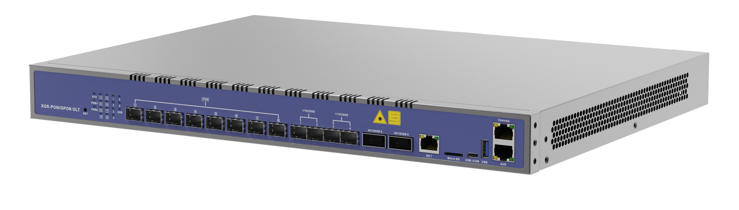



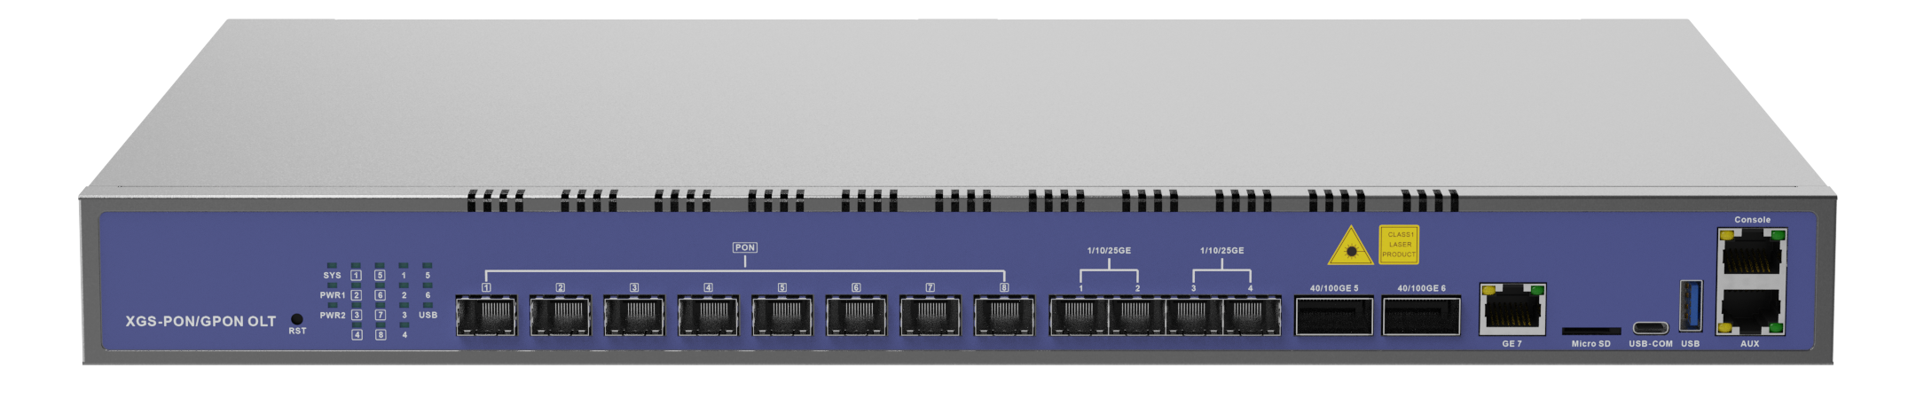
HV3600G1-C
8-Port 10G Combo PON/GPON OLT
Highlights
High Performance Chipset
100Gbps QSFP28 High-Speed Uplink
Supports XGS-PON/XG-PON/GPON triple mode for Flexible Networking
Introduction:
HV3600G1-C is an innovative 10G GPON OLT product with 8 PON ports and XG (S) - PON&GPON Combo compatibility, and also supports single GPON mode, giving customers more networking possibilities and facilitating customers to flexibly choose the appropriate bandwidth access mode according to current application conditions and future business upgrades. In the early stage of construction, customers can choose to consider reducing investment costs and switch any of the 8 PONs to single GPON mode, and then switch to XG(S)-PON&GPON Combo mode according to business needs in the future; they can also choose the smooth upgrade from GPON to XG(S)-PON, and switch to XG(S)-PON&GPON Combo mode in the early stage, considering the stability of the original business during future upgrades.HV3600G1-C provides 1*GE (RJ45) + 4*25GE (SFP28) + 2*100GE (QSFP28) uplink ports to achieve full-speed data forwarding and meet the needs of high-bandwidth, high-speed data transmission and large-scale deployment.
Interface of HV3600G1-C:
MicroSD
USB-COM
XG(S)-PON/GPON
4×10/25GE
(SFP28)
2×40/50/100GE
(QSFP28)
USB
Ordering Information:
1GE
(RJ45)
Console & Mgmt ports
Product Name | Product Description | Power Configuration | Accessories
HV3600G1-C | 8*XG(S)-PON/GPON, 1*GE(RJ45)+ 4*25GE(SFP28)+2*100GE(QSFP28) | 1*AC power; 2*AC power; | N2_C+ module; Class C++++ module(Single GPON mode); 100GE QSFP28 module; 25GE SFP28 module;

Slide 2
Technical Specifications
Item |  | HV3600G1-C
Chassis | Rack | 1U 19Inch Standard Box
Uplink Port | QTY | 8
 | RJ45(GE) | 1
 | SFP28(25GE) | 4
 | QSFP28(25GE/50GE/100GE) | 2
XG(S)-PON/GPON Port | QTY | 8
 | Physical Interface | SFP+ Slots
 | Connector Type | XG(S)-PON&GPON Combo mode: N2_C+
 |  | Single GPON mode: Class B+/C/C+/C++/C+++/C++++
 | Optical Splitting Ratio | 1:256(Maximum), 1:128(Recommended)
Management Ports |  | 1*10/100/1000BASE-T out-band port, 1*CONSOLE port, 1*USB3.0, 1*Type-C USB console, 1*MicroSD port
Backplane Bandwidth (Gbps) |  | 1960
Port Forwarding Rate(Mpps) |  | 566.928
XG(S)-PON&GPON Combo Port Specification | Transmission Distance | 20KM
 | XG(S)-PON Port Speed | GPON:Upstream1.244Gbps,Downstream 2.488Gbps XG-PON: Upstream 2.488Gbps, Downstream 9.953Gbps XGS-PON: Upstream 9.953Gbps, Downstream 9.953Gbps
 | Wavelength | GPON:Upstream 1310nm, Downstream 1490nm XG(S)-PON:Upstream: 1270nm Downstream: 1577nm
 | Supported PON ports | PON 1~8 (8 PON ports are in XG(S)-PON&GPON Combo mode by default )
GPON Port Specification | Transmission Distance | 20KM
 | GPON Port Speed | Upstream: 1.244Gbps,Downstream: 2.488Gbps
 | Wavelength | Upstream: 1310nm, Downstream: 1490nm
 | Supported PON ports | PON 1~8 (Each PON port can be manually hot-switch to GPON mode)
Lightning Protection | Power Lightning Protection | 6KV
 | Interface Lightning Protection | 4KV
Power Supply | AC | Working Voltage Range: 100~240V, Rated Voltage: 110V/220V
Number of Fans |  | 4
Management Mode |  | CLI(Console/Telnet/SSH)/WEB/SNMP
Management Function
SNMP,Telnet,CLI,WEB,SSH v2;
Fan Group Control
Port Status monitoring and configuration management
Online ONTconfiguration and management
User management
Alarm management
Layer2 Switch
32K Mac address
Support 4096 VLANs
Support port VLAN
Support VLAN tag/Un-tag, VLAN transparent transmission
Support VLAN translation and QinQ
Support storm control based on port
Support port isolation
Support port rate limitation
Support 802.1D and 802.1W
Support static LACP,Dynamic LACP
QoS based on port, VID, TOS and MAC address
Access control list
IEEE802.x flowcontrol
Port stability statistic and monitoring
DHCP
DHCP server,DHCP relay,DHCP snooping
DHCP option82
Layer 3 Route
ARP proxy
4096 hardware Host Routes,512 hardware Subnet Routes
Support Radius,Tacacs+
Support IP source guard
Support static route ,dynamic route RIP v1/v2,RIPng and OSPF v2/v3;
IPv6
Support NDP;
Support IPv6 Ping,IPv6 Telnet,IPv6 routing;
Support ACL based on source IPv6 address, destination IPv6 address, L4 port, protocol type, etc;
Support MLD v1/v2 snooping
Support ONT auto-discovery/link detection/remote upgrade of software
Support VLAN division and user separation to avoid broadcast storm
Support power-off alarm function, easy for link problem detection
Support broadcasting storm resistance function
Support port isolation between different ports
Support ACL and SNMP to configure data packet filter flexibly
Specialized design for system breakdown prevention to maintain stable system
Support RSTP,IGMP Proxy
Dimension (L*W*H)
442mm*330mm*43.6mm
Weight
Net weight : 4.8 KG
Power Consumption
150W
Working Environment
Working Temperature: -20°C ~+60°C
Working Humidity: 5%~95%(non-condensing)
Storage Environment
Storage Temperature: -40 ~ +70°C
Storage Humidity: 5%~95%(non-condensing)
PON Function
T-CONT DBA
x-GEM traffic
In compliant with ITU-T G.9807(XGS-PON) ,ITU-T G.987(XG-PON) and ITU-T 984.x
Up to 20KM transmission Distance
Support data encryption, multi-cast, port VLAN, separation, RSTP, etc
Multicast
IGMP snooping
2048 IP Multicast Groups;

