Slide 1
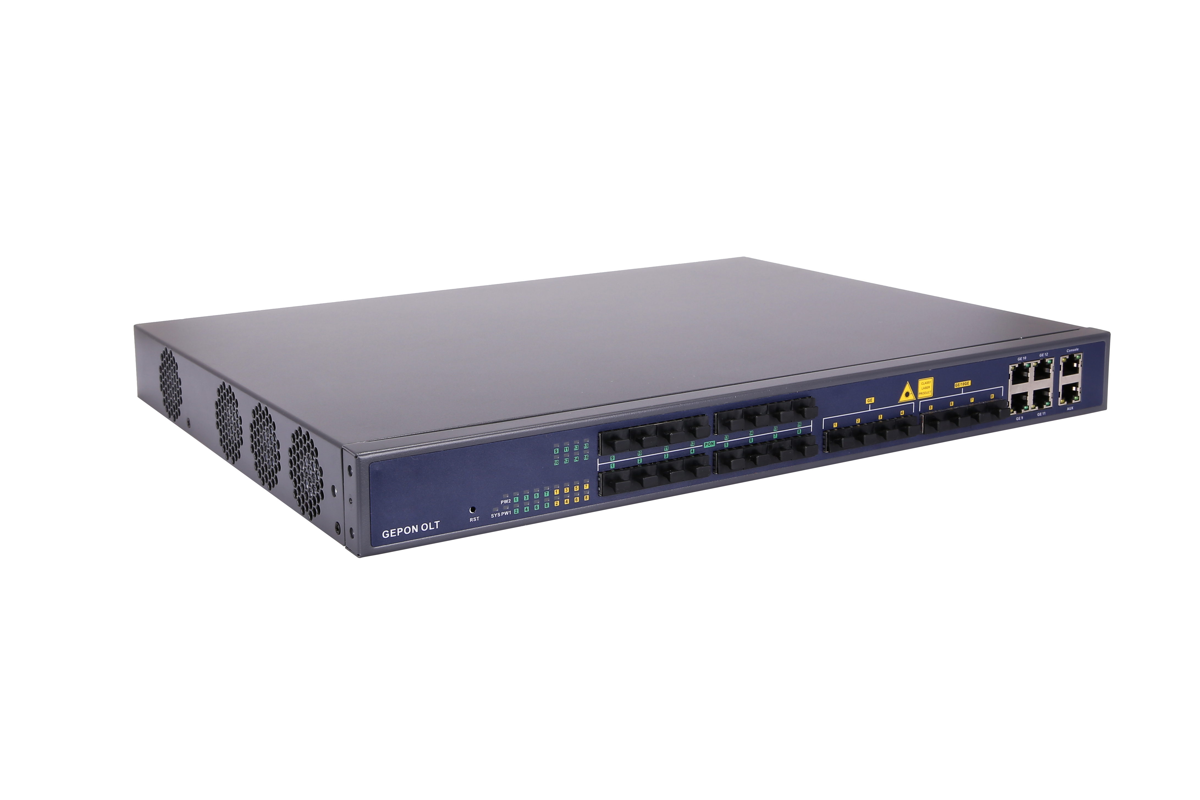


HV1600D16
Key Features:
STP/RSTP/MSTP
IGMP Snooping
VLAN Translation/Q-in-Q
Port Aggregation
Dynamic Bandwidth Allocation
DHCP Snooping
ACL
Port Mirroring
L3 Static Route, RIP/OSPF
SNMP/Telnet/CLI/WEB/SSH
Layer3 16 Ports EPON OLT
Introduction:
HV1600D16 series EPON OLT products are 1U height 19 inch rack mount products. The features of the OLT are small, convenient, flexible, easy todeploy and high performance. It is appropriate to be deployed in compact room environment. The OLT's can be used for "Triple-Play", VPN, IP Camera, Enterprise LAN and Internet service provider applications.
HV1600D16 provides 4GE(copper) and 8*SFP slots independent interface for uplink, and 16*EPON OLT ports for downlink. It can support overall 1024 ONU's with 64 ONU's per PON port.
Technical Specifications:
Management Ports
1*10/100BASE-T out-band port, 1*CONSOLE port
Online ONU configuration and management;
User management, Alarm management
Multicast
IGMP snooping
256 IP Multicast Groups
PON Port Specification
Transmission Distance: 20KM
EPON port speed” Symmetrical 1.25Gbps
Wavelength: TX-1490nm, RX-1310nm
Connector: SC/UPC
Fiber Type: 9/125μm SMF
Layer 2 Feature
DHCP
16K MAC address
Support port VLAN
Support 4096 VLANs
Support VLAN tag/Un-tag, VLAN transparent transmission, QinQ
Support IEEE802.3d trunk
Support RSTP, MSTP
QoS based on port, VID, TOS and MAC address
IEEE802.x flow control
Port stability statistic and monitoring;
Support P2P Function
DHCP server
DHCP relay
DHCP snooping
Layer 3 Features
ARP proxy
Static route
1024 hardware Host Routes
512 hardware Subnet Routes
Support RIPv1/v2, OSPFv2/v3
Support PPPoE+
Management Mode
SNMP/Telnet/CLI/WEB/SSH v2
Management Function
Fan Group Control;
Port Status monitoring and configuration management;

Slide 2
HV1600D16 16 Ports EPON OLT
Technical Specifications:
Security Management
EPON Function
Support power-off alarm function, easy for link problem detection
Support broadcasting storm resistance function
Support port isolation between different ports
Support ACL to configure data packet filter flexibly
Specialized design for system breakdown prevention to maintain stable system
Support dynamic distance calculation on EMS online
Support IEEE802.1x, Radius, Tacacs+
Support DHCP Snooping,DHCP Opiton82, IP Source Guard
Support HTTPs, SSHv2
Support port-based rate limitation and bandwidth control
In compliant with IEEE802.3ah standard
Support data encryption, multi-cast, port VLAN, separation, RSTP, etc
Support Dynamic Bandwidth Allocation (DBA)
Support ONU auto-discovery/link detection/remote upgrade of software
Support VLAN division and user separation to avoid broadcast storm
Support various LLID configuration and single LLID configuration
Different user and different service could provide different QoS by means of different LLID channels
IPv6 Feature
Support IPv6 Neighbor Discovery, SLAAC Snooping
Support DHCPv6 Server,DHPCv6 Relay,DHCPv6 Snooping
Support IPV6 Static Route
Support IPV6 Dynamic Route Protocol: RIPng,OSPF6
Support MLD V1/V2
Support IPv6 ACL
Support IPv6 SNMP,Telnet,Https,SSH management
Item |  | HV1600D16
Chassis | Rack | 1U 19 inch standard box
Uplink Port | Port count | 12
 | Copper | 4*10/100/1000M auto-negotiation
 | SFP(1GE) | 4
 | SFP+(10GE) | 4
EPON Port | QTY | 16
 | Physical Interface | SFP Slots
 | Max splitting ratio | 1:64
 | Supported PON module level | PX20, PX20+, PX20++, PX20+++
Backplane Bandwidth (Gbps) |  | 128
Port Forwarding Rate(Mpps) |  | 95.232
Dimension (LxWxH) |  | 442mm*320mm*43mm
Weight |  | 6.5kg
Power Consumption |  | 95W
Power supply | AC | Working Voltage Range: 100~240V, Rated Voltage: 110V/220V
 | DC
 |  | Working Voltage Range: -36~-75V, Rated Voltage: -48V/-60V
Operating Environment | Working Temperature | -20~+60°C
 | Storage Temperature | -40~+70°C
 | Relative Humidity | 5~95% (non-condensing)
Ordering Information:
Product Name | Product Description | Power Configuration | Accessories
HV1600D16 | 16*EPON,4*RJ45+ 4*SFP+4*(SFP+) | 1*AC power 2*AC power 1*AC power + 1* DC power | EPON SFP PX20++ module EPON SFP PX20+++ module 1G SFP module 10G SFP+ module

